Slide 1
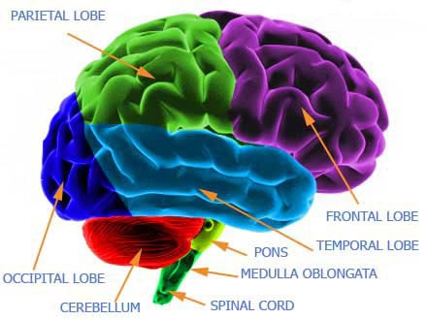
Your Brain Is Active When You Sleep
By: Claire Saavedra

Slide 2
Why I Picked This Topic
Ever since I went to freshman orientation I was really engaged about what Mr. Homer was lecturing. He was talking about how our brains work while we were sleeping and at that time I did not knew anything about the brain.
What I Already Know
Sleeping Late (Last Year)
Breast Cancer
Lowers Estrogen
Rats → Melatonin
Gain Weight

Slide 3
Story of My Research
I asked Ms. Aho about my research because she is the health teacher and she gave me a list of trusted health websites she approves of and her own knowledge about my topic.

Slide 4
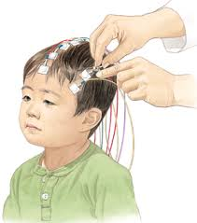
What I Learned (Or Did Not)
Electroencephalogram: Detects the wavelengths (activity) in your brain. Usually used for people who have sleeping disorders.
1st state is NREM (dreamless sleep) divided by 4 stages
75%
Breathing is nice and slow
1st stage is being in the middle of being awake & falling asleep.
Hypnic Myoclonia (Story)
Small undulations
2nd stage eye movement stops &brainwaves shift from normal to slow.
Temperature drops
Disengage surrounding
Breathing & Heart rate is normal

Slide 5
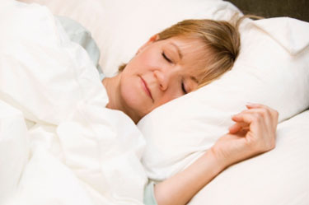
Continued…
3rd and 4th stage (Deep Sleep)
Sleep Walk, Etc.
Delta Waves
Blood Pressure Drops
Muscles Relaxed
Tissue Growth
Energy is Stored
Hormones are released
2nd State REM
25%
Provide Energy to brain and body
Dreams Occur
Support Daytime Service
Sleep
< 6 hours

Slide 6
My Reflection
I Search
Learning new things → Helpful Info.
Did not relate
Decision

Slide 7
Resources
http://www.ninds.nih.gov/disorders/brain_basics/understanding_sleep.htm
http://sleepfoundation.org/how-sleep-works/what-happens-when-you-sleep
http://www.dailymail.co.uk/health/article-90598/What-happens-body-youre-asleep.html
http://www.medicaldaily.com/lack-sleep-light-night-can-raise-cancer-risk-238184

