Slide 1
How Can We Help Marine Animals?
Claire Saavedra

Slide 2
Answer
Pick up garbage
Park, Rivers, Lakes, Your Home, Etc.
All ends up in the ocean
Why?
We are basically killing the marine animals if we don’t
They are part of our food chain if it breaks then other animals will die too
Have you seen the Lorax? If not please watch it
They will be extinct
75-80 % of Earth is made up of Water

Slide 3
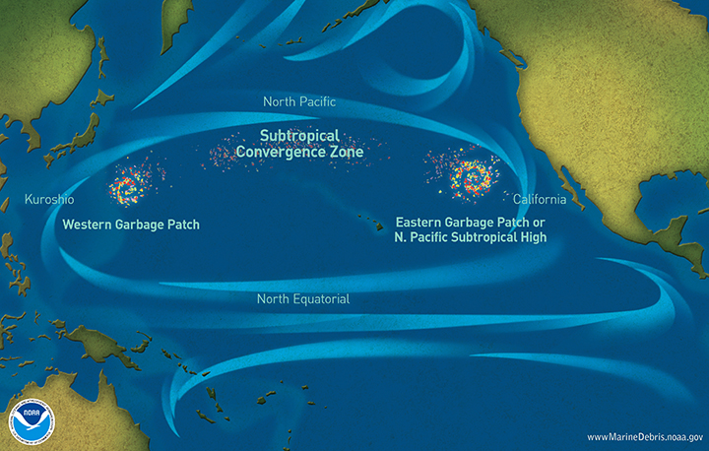
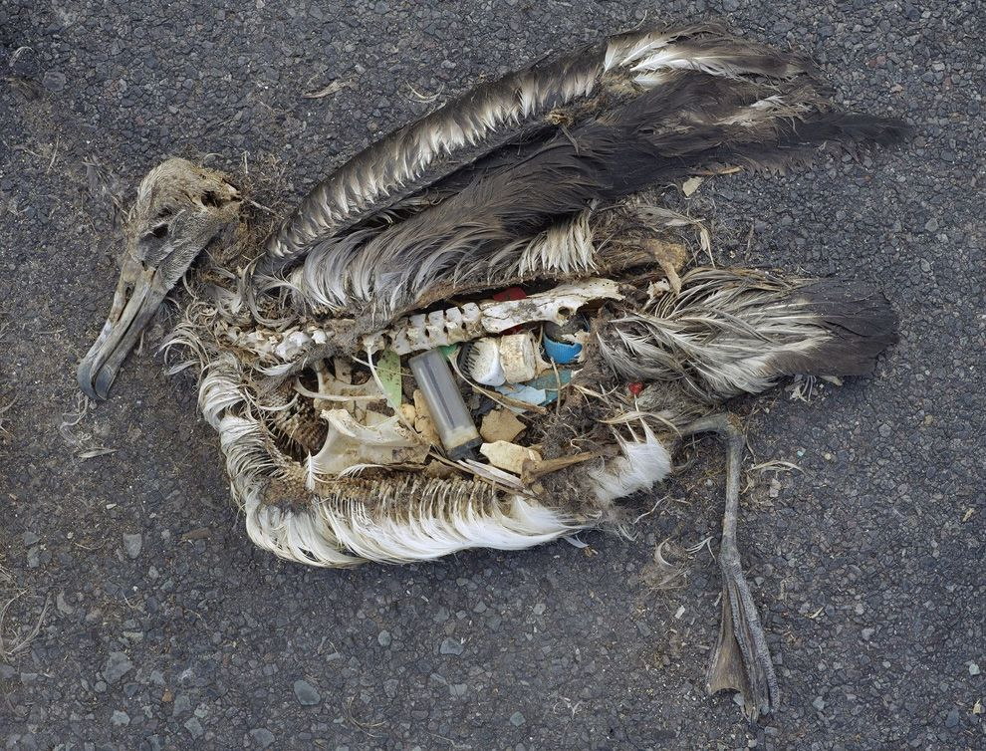
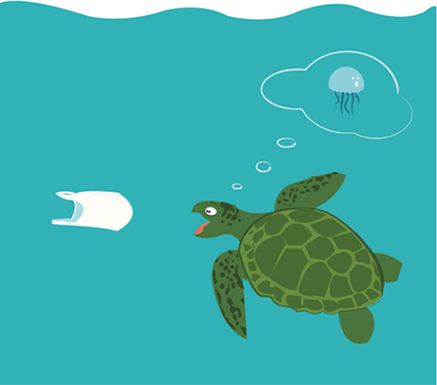
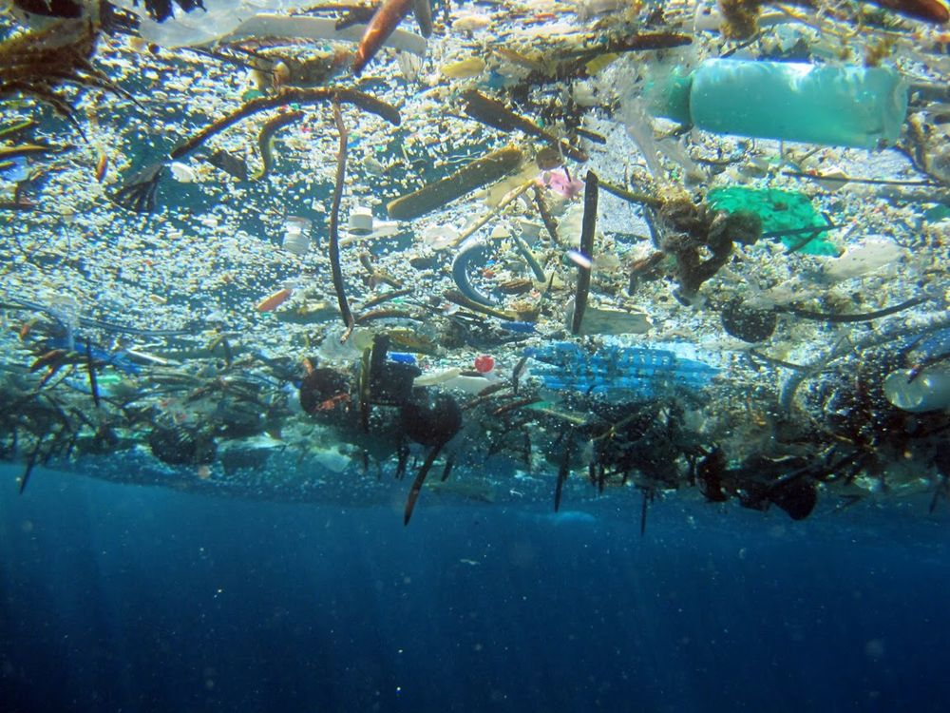
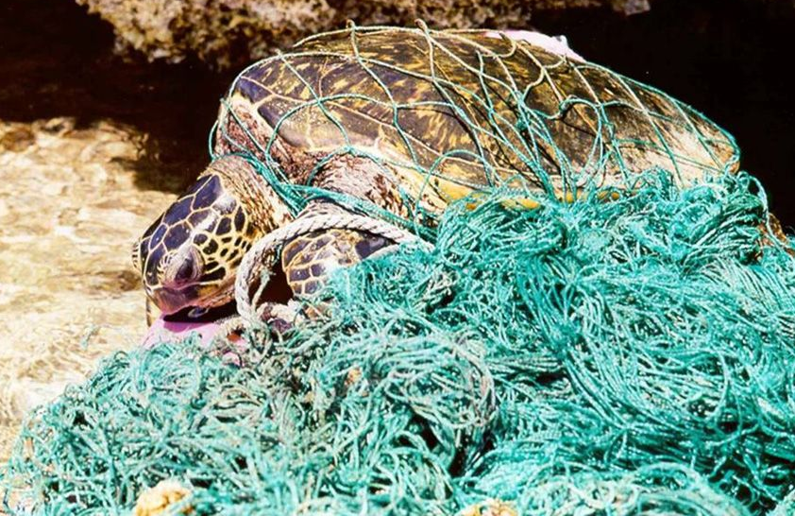
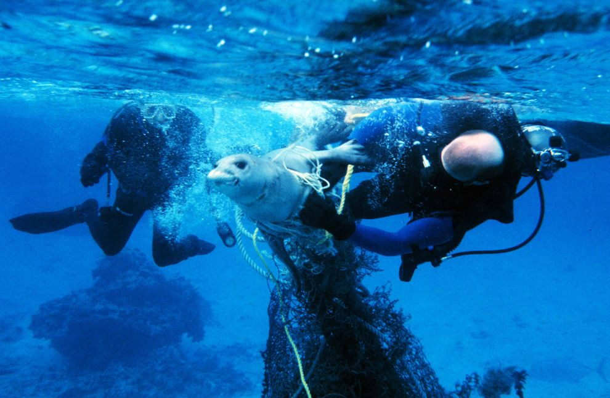

Slide 4
Dear Future Generation

