Slide 1
☻♫ Claire Saavedra ♪ ☺
B2

Slide 2
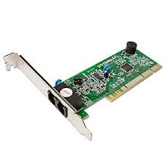
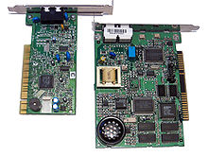
Modem
A modem is a device used for internet at your home

Slide 3
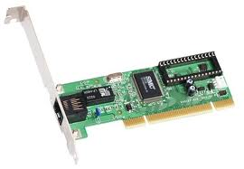
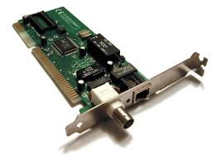
Network Card
A network card is a card that connects to the computer network.

Slide 4
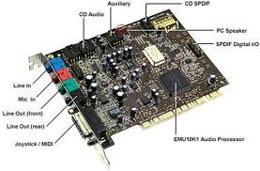
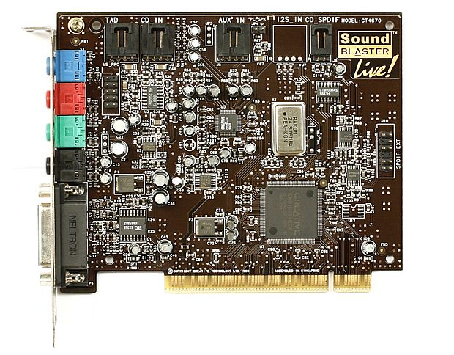
Sound Card
A sound card is an internal computer expansion card that facilitates the input and output of audio signals to and from a computer.

Slide 5
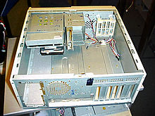
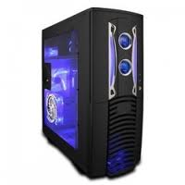
Case
A case is the enclosure that contains most of the components of a computer, like a keyboard and a mouse.

Slide 6
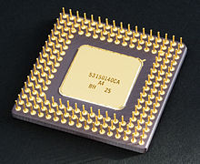
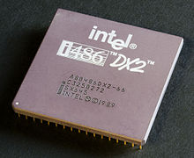
CPU
A CPU stands for central processing unit it is a hardware within a computer system or smartphone which carries out the instruction of a program

Slide 7
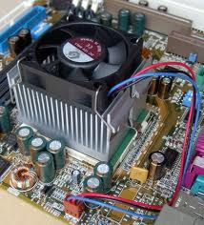
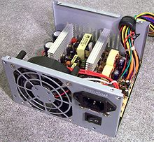
FAN
A Fan coverts mains AC to low-voltage regulated DC power for the internal components of a computer.

Slide 8
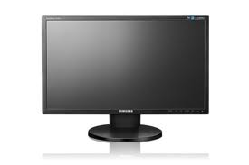
Monitor
The screen that show the computer

Slide 9
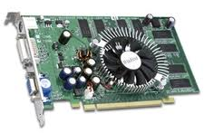
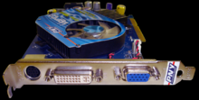
Video Card
A video card is an expansion card which generates a feed of output images to a display.

Slide 10
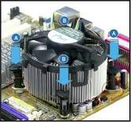
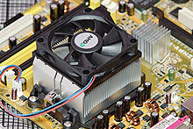
Heatsink
A heat sink is a passive component that cools a device by dispersing heat into the surrounding air.

Slide 11
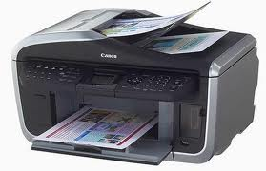
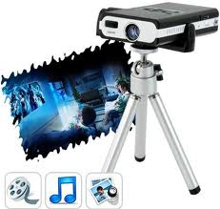
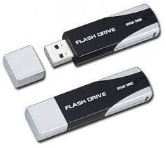
Output Device
An output device is a hardware device that is used to give the results of processed data.

Slide 12
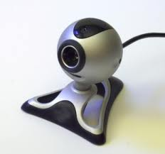
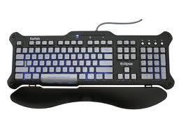
Input Device
An input device is any peripheral (piece of computer hardware) used to provide data and control signals to an information processing system such as a computer or other information appliance

Slide 13
Software
Software is a collection of
computer programs and related
data that that provides the instructions
for telling a computer what
to do and how to do it.

Slide 14
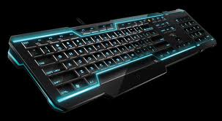
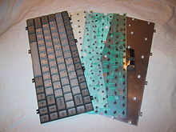
Keyboard
Keyboards have 80-110 durable switches.
We use Keyboards to type essays, URL’s, etc.

Slide 15
Mouse
Mouse is a pointing device that functions by detecting two dimensional motion relative to its supporting surface.

Slide 16
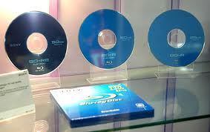
Blue-Ray disc
Blue Ray disc is an optical disc storage medium designed to supersede the DVD format. It contains 25 GB per layer, with dual layer discs.

Slide 17
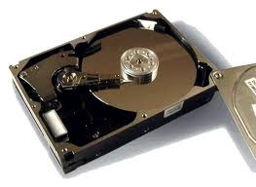
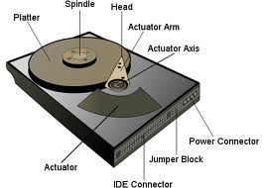
Hard Drive
A hard drive is a data storage device used for storing and retrieving digital information from non-volatile memory in a random access manner.

Slide 18
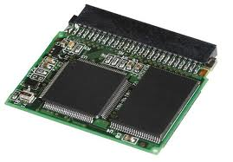
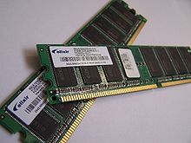
RAM + ROM
ROM – Stands for Read Only Memory
it’s a class of storage medium used in
computers and other electronic devices.
RAM – Stands for Random access
Memory it’s a form of computer data
Storage.

