Slide 1
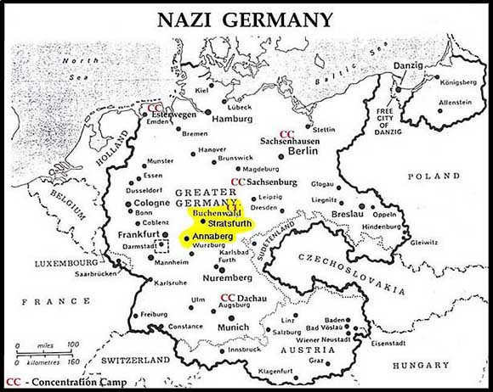
Buchenwald
By: Claire Saavedra

Slide 2
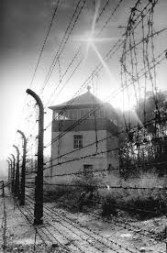
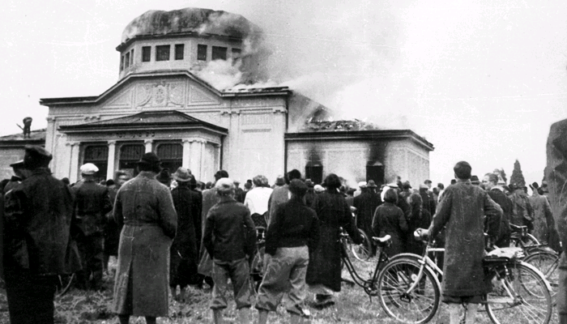
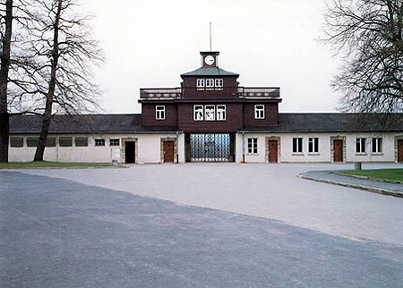
What is Buchenwald?
Buchenwald was one of the largest concentration camp
Male prisoners July 1937.
Female Prisoners
In 1938 , aftermath of Kristallnacht, German SS and police
sent almost 10,000 Jews and subjected them to cruel treatment
Buchenwald became a synonym for the Nazi concentration camp.
Kristallnacht
Buchenwald

Slide 3
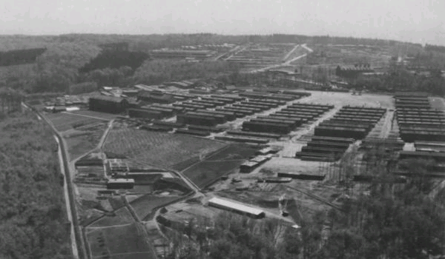
Where is it Buchenwald?
The camp was constructed by Nazi’s in 1937 in a wooden area northeast of Weimar in central Germany.

Slide 4
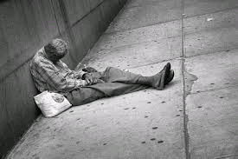
What was the Purpose?
Combat political opponents
Persecute Jews, Sinti, Roma, and permanently exclude “strangers to the community”
Examples of strangers of community are….
Homosexuals
Jehovah's witnesses (A religion)
The Homeless
Ex Convicts

Slide 5
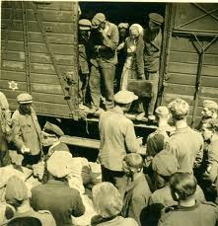
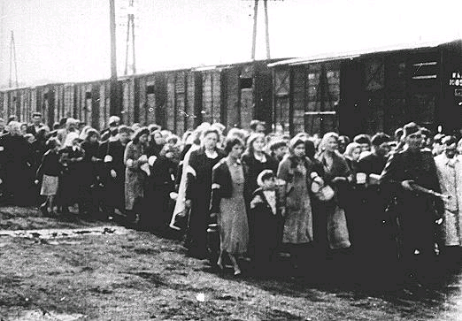
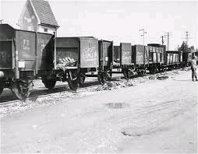
After the War Begins
Deported to all over Europe.
All together > 250,000 persons are imprisoned

Slide 6
By the End of The War
More than 56,000 die there as the result of torture, medical experiments, and consumption.
When the Americans Reach Buchenwald and its sub-camps.
U.S. forces……April 1945
>20,000 prisoners
Dwight D. Eisenhower

Slide 7
Resources
http://www.buchenwald.de/en/72/
http://www.ushmm.org/wlc/en/article.php?ModuleId=10005198
http://www.nizkor.org/hweb/camps/buchenwald/press/reuters-040395b.html
http://www.jewishgen.org/forgottencamps/camps/buchenwaldeng.html

