Slide 1
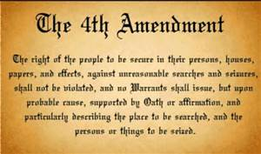
4th Amendment
By: Claire Saavedra & Sabrina Reyes

Slide 2
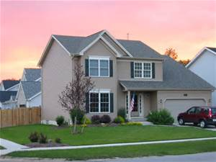
Definition
“The right of the people to be secured in their persons, houses, papers, and effects against unreasonable searches and seizures, shall not be violated, and no Warrants shall issue, but upon probable cause, supported by Oath or affirmation, and particularly describing the place to be searched, and the persons or things to be seized.”
It protects people from unreasonable searches and seizure by the government.

Slide 3
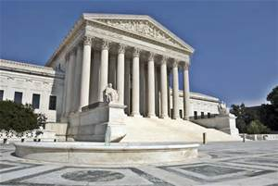
Court Cases
Mapp V. Ohio
Exclusionary Rule
Redding V. Safford Unified School District

Slide 4
Unresolved Issues
NSA (National Security Agency)
Cell phone Privacy

